Slide 1
Why Data Analytics?

Slide 2
Data is everywhere
What is intriguing about data analytics is that data can be captured and from just about anywhere.
Data Analyst are found in all faucets of business
Medical
Financial
Technical
Education
Marketing
And Government

Slide 3
Who has the skills can get the job
Data analyst can take a data set of millions of categories and extract the useful and create the most useful information from it that can shape the future.
You can not argue with quantifiable facts.

Slide 4
Articles
“As much as COVID-19 dominates our thinking today, we should also remember two points: data analytics was important before the pandemic, and it will remain important after our global ordeal finally goes away” ( https://www.smarsh.com/thought-leadership/data-analytics-and-the-future-of-compliance/ , 09/08/2020).

Slide 5
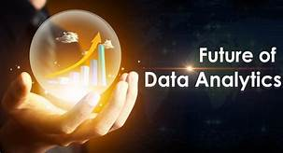
Data Analytics is the future

